Slide 1

DISK USAGE ALARM AND SENDING FILES TO RECYCLE BIN
SCENARIO 7 AND 8
MADE BY – Ishika singh
R171217024
DEVOPS

Slide 2
How to monitor the disk usage and alert if it is beyond threshold?
Why is there a need for disk usage?
1.In companies the logs generated in a single day are in gigabytes and terabytes.
So it is obvious that the companies might run out of space to store these files.
2. So there is a need to clear older log files, which are no further needed.
3.There must be a particular retention period fixed , after which the log files should be deleted automatically.

Slide 3
4. We know that due to lack of storage the operating system will run out of space and this will result in failure of everything.
5. In Linux everything is in form of a file. A file is stored in a hard disk and if the hard disk is full this will lead to complete paralysis.
TO AVOID THIS
Disk should be checked and action should be taken before its reaches a critical stage.

Slide 4
Let us program a script for the same
First of all our program needs to know which hard disk to monitor i.e. in which storage device are all files being saved.
The program also needs to know what is the threshold limit .
We need to validate i.e. recheck the given inputs . Why ???
To be sure that the correct disk storage is being monitored and the threshold storage is greater than disk size.
If it is correct then show the appropriate errors and exit.
But if the disk usage is more than the threshold limit then simply an email can be sent.
Finally to do this regularly and frequently , schedule it to the cron to get executed every minute. Why cron ?
As cron is a time based job scheduler.

Slide 5
Pseudocode
Read Argument- The device name for which the usage should be monitored.
Read Argument- Threshold limit beyond which the user should be alerted.
Check- No device exists with the given device name.(validate that the program is monitoring the correct file).
True- Throw an error and write to the logs.
Check- Threshold limit is greater than size of the disk.
True- Throw an error and write to the logs.
Run the disk utility command to get the usage of the disk.
Check - Disk usage is greater than the threshold limit.
True- Write to the etc/motd file so that it will be shown whenever a user logs in.
Check – The script is scheduled in the cron.
False- add the script to the cron so it gets executed every minute.

Slide 6
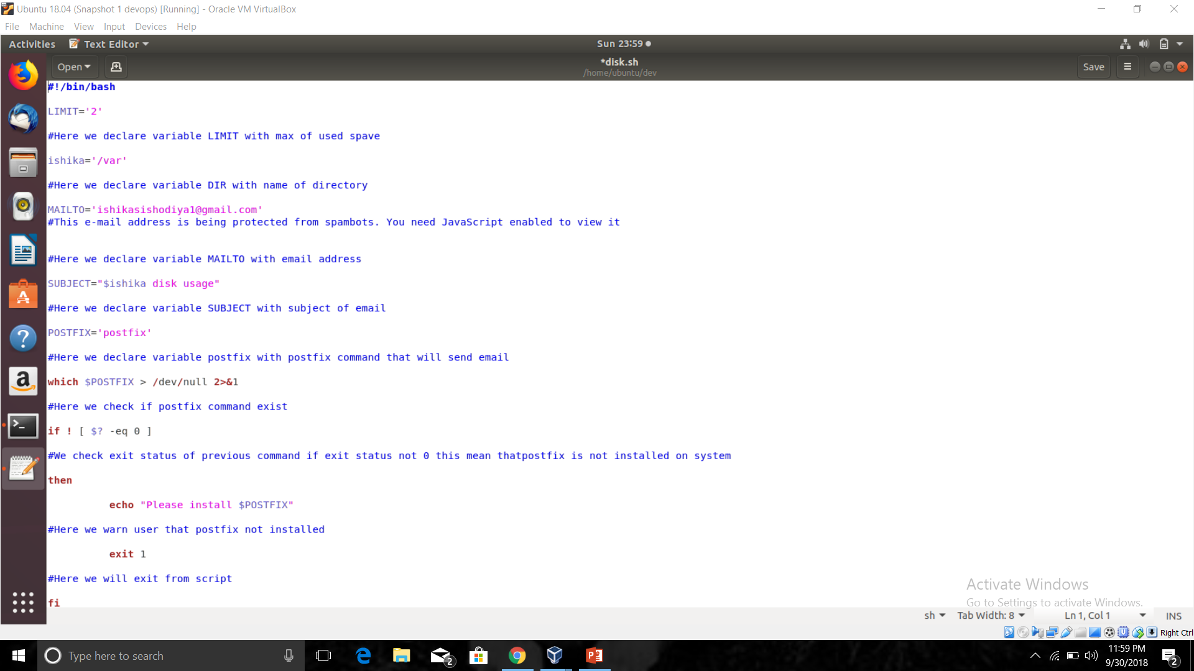

Slide 7
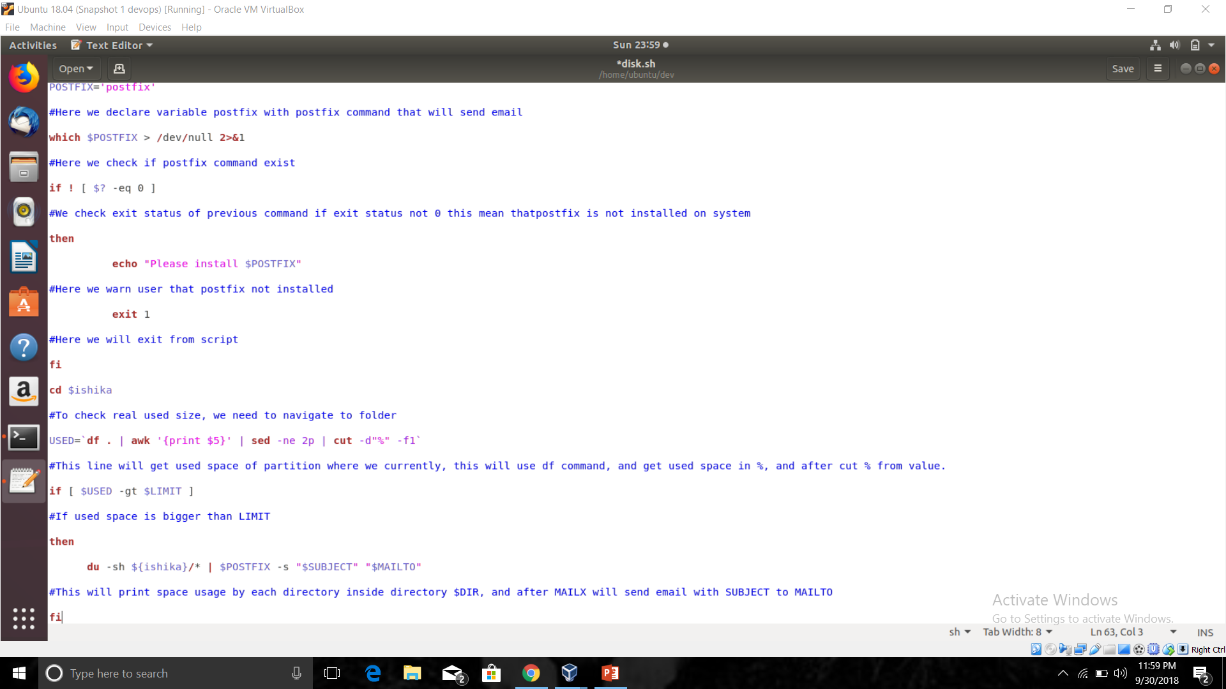

Slide 8
How to move deleted files or folder to the recycle bin?
Need of recycle bin?
It is possible that even an experienced person can delete a very important file by mistake. So it is better to have a stage between deleting a file and having a file.( A place where our files can sit for some period of time and there is possibility of restoring them.
-In windows we are provided with a recycle bin .
-In Linux we can create one.

Slide 9
Set the temporary directory for the deleted files.
We should have a path that actually deletes the file and the path that copies the file.
We need the files or folders to be deleted as input. If inputs are not given then throw an error asking for input. (input =file path)
Then we can create the recycle bin if it doesn't exist in the specified path.
Now copy the file or folder that we attempted to delete using the script to the recycle bin and then delete the actual file using rm tool.
If ‘f’ (indicating force ) Is given in the argument then skip previous step and delete the file directly.

Slide 10
Pseudocode
Set the location of the recycle bin directory and the location of remove copy tool.
If there are no arguments given, then throw an error asking to provide the file as argument.
Create a recycle bin directory.
Copy the files to the recycle bin and prefix the dates of the file.
Provide all other arguments and file paths to the remove utility.

Slide 11
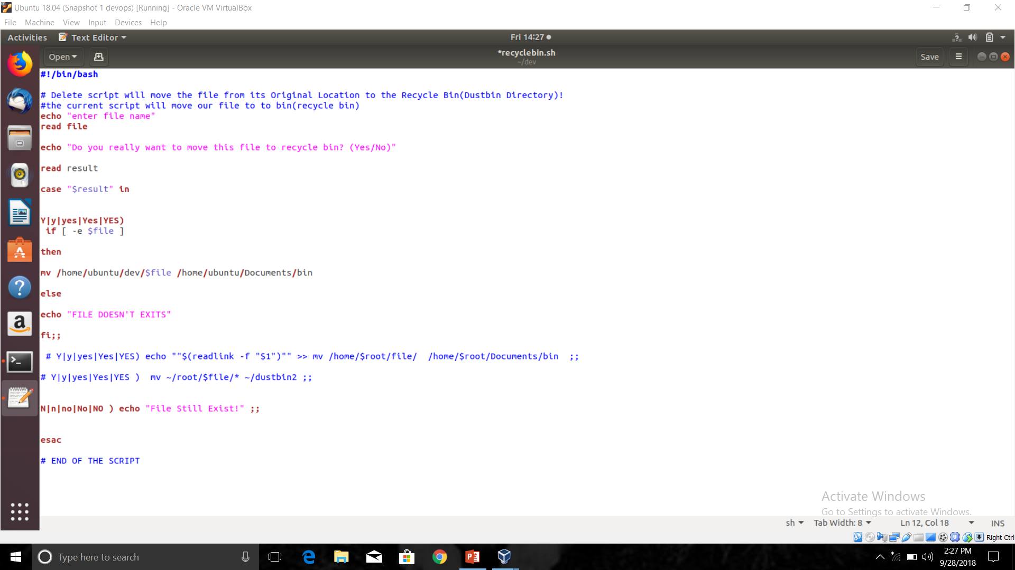

Slide 12
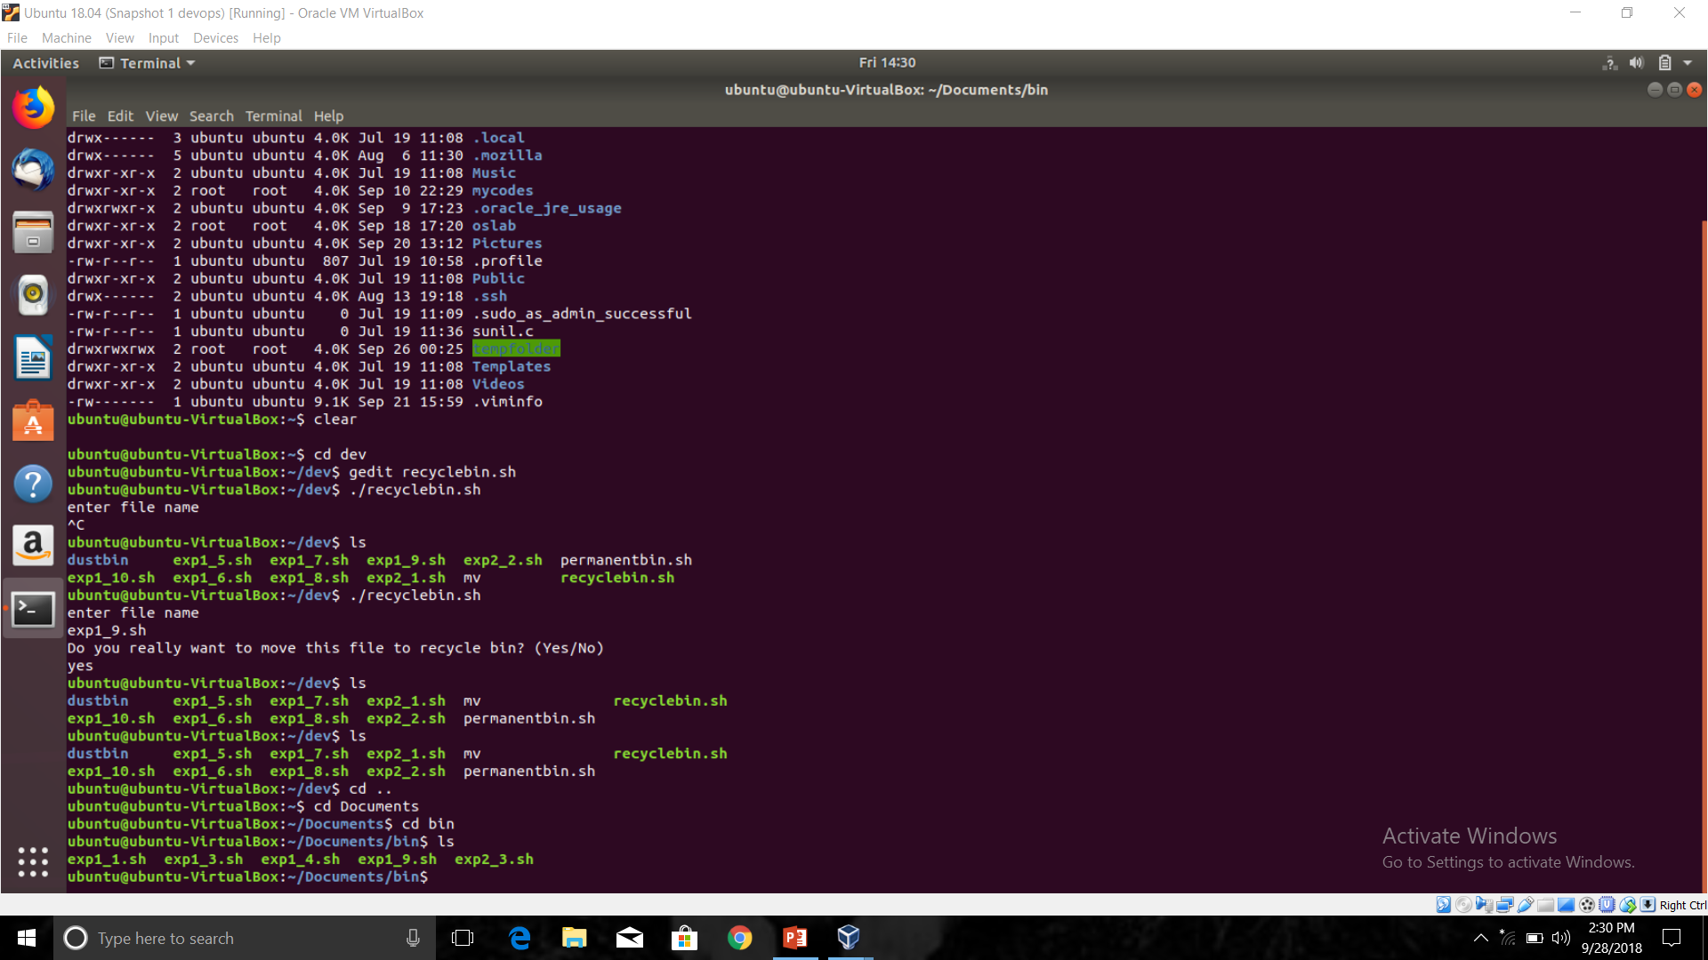

Slide 13
THANKYOU

